Slide 1
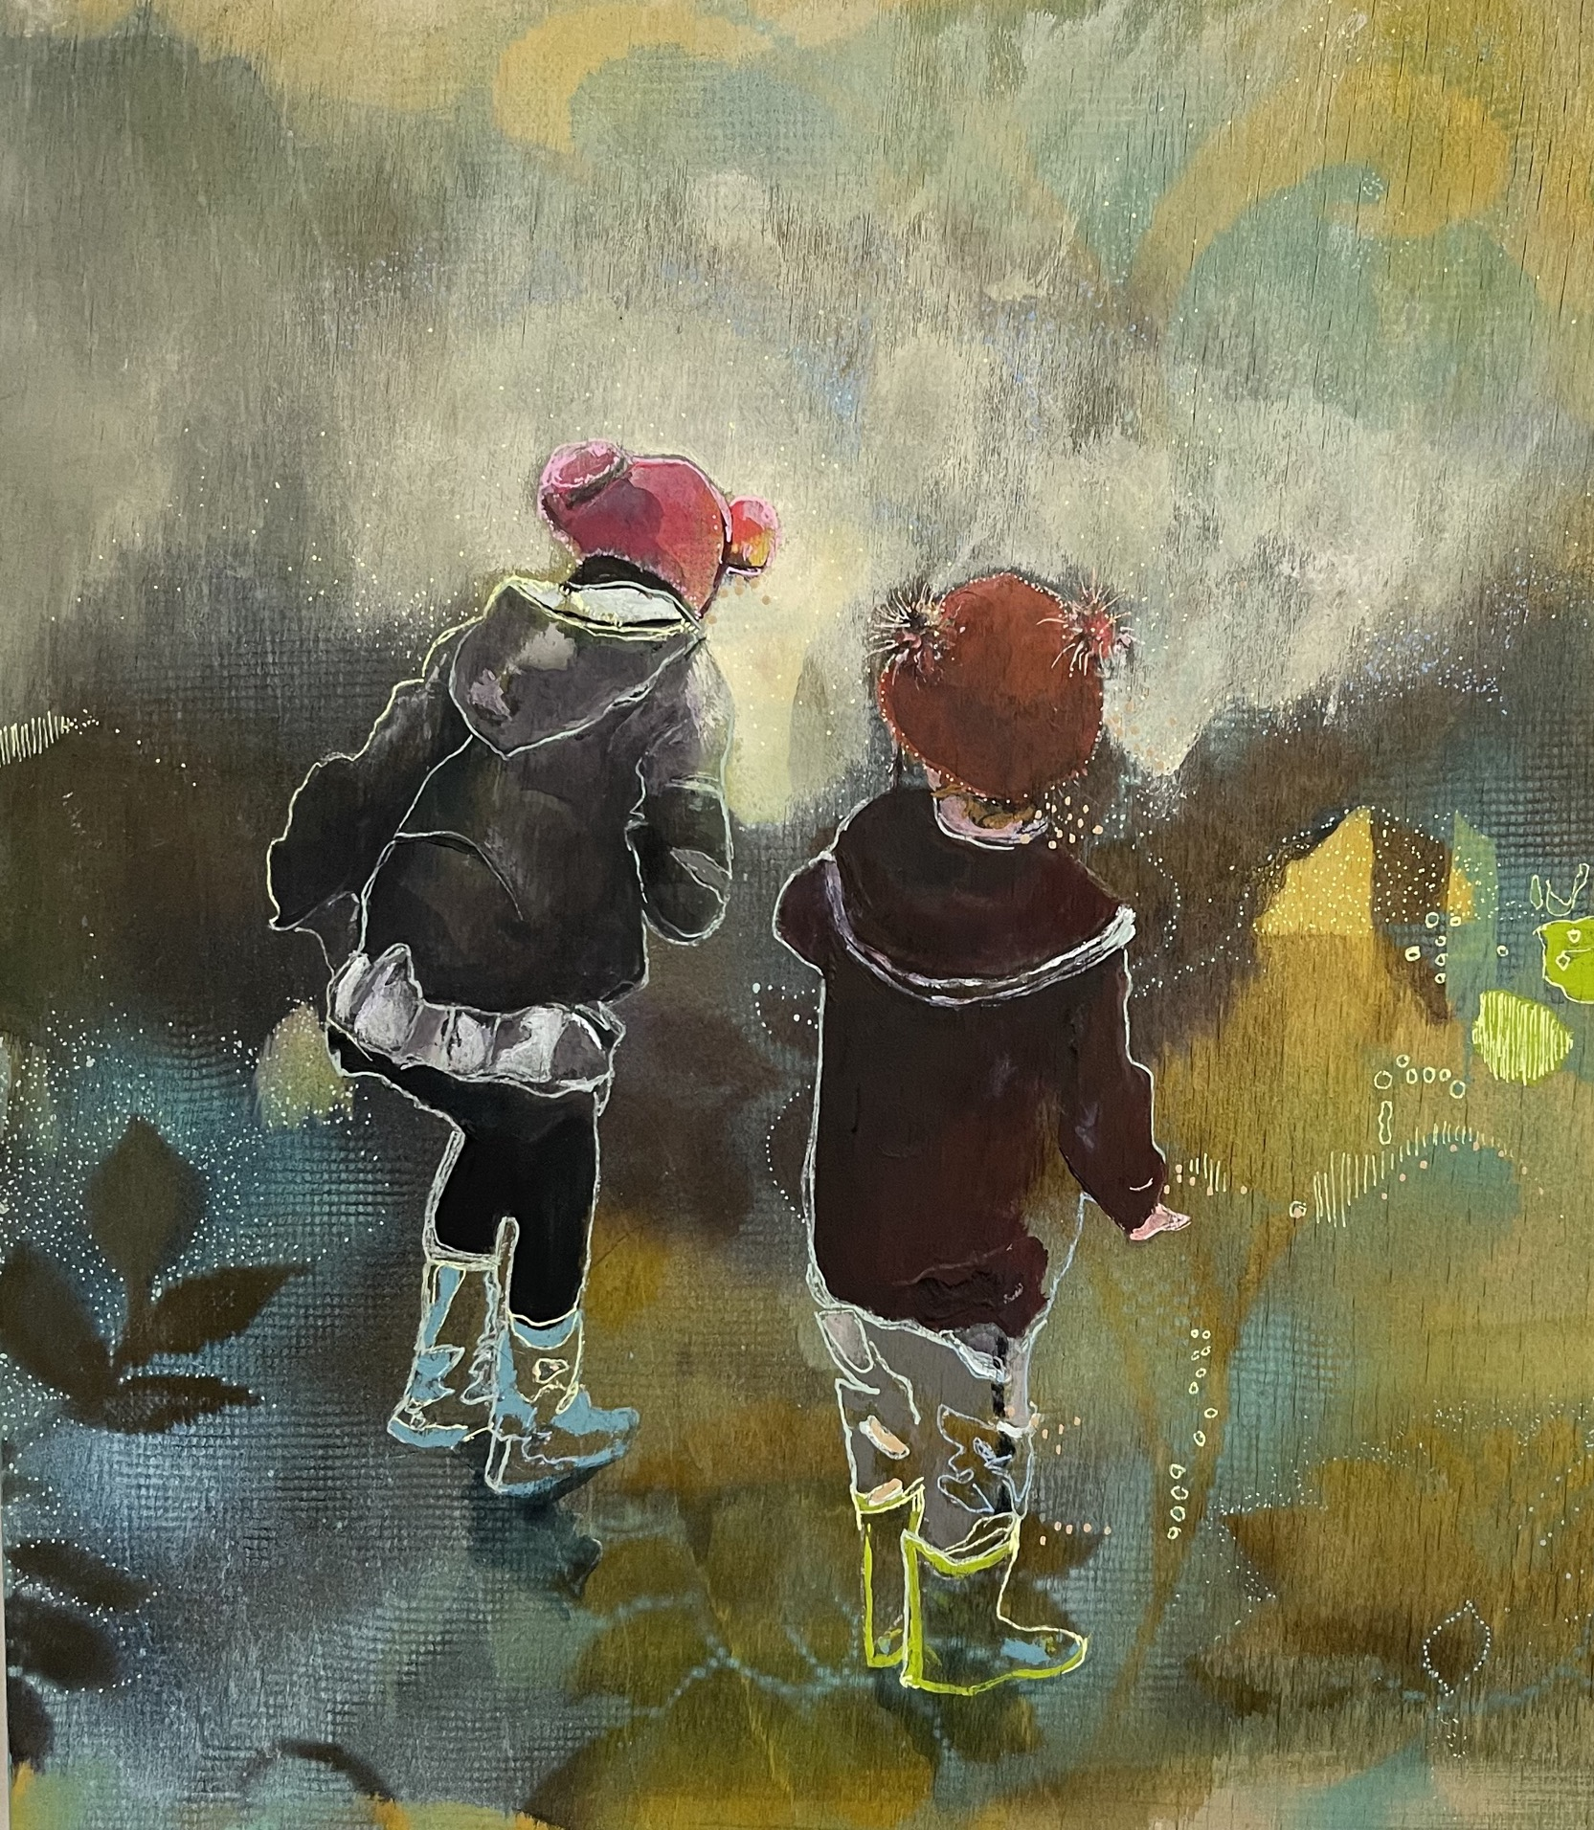
Threads and Strands: An Arts-Based investigation of Intersecting identities of Mother, Academic and Creative Practitioner
Frances Sullivan-Rhodes
Doctor of Philosophy (Education)
Milestone 1 Presentation Feb 11th 2025
Supervisors: A/Prof Lisa Paris, A/Prof Madeleine Dobson & Dr Kathryne Ford
Thesis Chair: Dr Sharon Davies

Slide 2
Acknowledgment
I wish to pay my respects to the traditional custodians of the lands on which I live and learn and work and to acknowledge that this has been a place of learning for millennia and that I am proud to be standing here and continuing to learn and contribute to the construction of knowledge in this place.

Slide 3
Positionality
Serial Migrant (originally from the UK)
Formerly Sessional Academic for 16 years (now on-going academic)
Mother for 14 years (so far) to one daughter and one son
Single Mother for 5 years (now re-married)
Professional Visual Artist for 27 years (so far) (Emic perspective)
Feminist
Ethic of Care
Radical Kindness
Ethics and Aesthetics
Previous PhD Candidate
Notes:
I mention these things because they bring be to the point of proposing this project

Slide 4
Introduction
I seek to illuminate the experiences of mothers who navigate the demands of academic responsibilities, professional creative practices and carer responsibilities. Grounded in a critical feminist framework, with particularly leaning toward matricentric feminism and employing Arts-Based research methodology, this study aims to explore how these intersecting identities shape mothers’ professional and personal lives.

Slide 5
Background
Art and Motherhood
Feminism and Motherhood
Motherhood/Women and Academia
Addressing the toll taken on women who face an imperative to chose between these strands of identity and the ensuing loss for the academy, the family and culture more broadly.
Notes:
So I’ve separated the background for this project into strands…
Also here as organiser for the writing

Slide 6
Hartford Wash (documentary Photograph of Performance Artwork, Dimensions Variable) Mierel Laderman Ukeles, 1964.
Notes:
Although there is a wealth of interesting, rich contemporary context to consider it is also important to acknowledge the art historical context that underpins this field of research.

Slide 7
Background – Feminism and Motherhood
Along with artists such Laderman Ukeles, writers such as Adrienne Rich contributed to carving out a place for mothering/motherhood in Feminist discourse, The broader philosophical context of the second half of the 20th century contributes to the establishment of this space for mothers within critical theory and practice
Matricentric/Maternal feminisms spring from this context.
On becoming mother, a woman’s subjectivity is split (Gilbert, Denson & Weidmann, 2022), which is inherently problematic for feminist critique. The emergence of matricentric feminism begins to ameliorate this perceived loss of whole self (Bueskens, 2018).
Notes:
. Adrienne Rich’s Of Woman Born (O’Reiley, 2007) presents an ethnographic inquiry of experiences of motherhood and the forces that have shaped the institution of motherhood. An institution is which certain identities are illegible and there exist other subtle ways in which some voices are legitimised and others denied.
One of the things that is really important in this context is the time in which Rich’s text emerges. The postmodern rejection of grand narratives posits the value of plurality, of celebrating difference, intersection, and refusing the totalising myth of a single experience of womanhood or motherhood (Lykke, 2010). Nina Lykke makes this claim for feminisms since the 1980s, informed by the work of both Adrienne Rich and Donna Harraway, should be “based on a bricolage of many small heterogenous stories rather than one grand coherent master narrative.” (Lykke, 2010)
This field has given rise to research exposing challenges and inequities in the experience of women in the workforce, with organisations such as the International Association of Maternal Action and Scholarship or Demeter Press which partners with the Journal of the Motherhood Initiative including works of narrative inquiry that collect the stories of mothering and managing creative practice from artist mothers (O’Reilly, 2019, Palfreyman et al, 2024).

Slide 8
Women – Art - Motherhood
Representations of Motherhood have shifted dramatically since the advent of Feminism.
Notes:
In terms of the art-historical context there have been significant shifts in the way that motherhood has been represented and consequently understood. We’ve moved from the idealised type of serene motherhood from Renaissance Madonnas or Impressionist gentle domesticity to the fleshy chaos of artists like Jenny Saville who in her representations of motherhood, references these traditional representations.

Slide 9
Jenny Saville. Mother and Children (After the Leonardo Cartoon). Charcoal on Paper. 2008

Slide 10
Leonardo Da Vinci. The Virgin and Child With Saint Anne and John the Baptist (Cartoon, Charcoal and Chalk on Tinted Paper). 1499-1500. National gallery of London.

Slide 11
Background and Context – Women in Academia
The importance of this project lies in acknowledging the effect on women in the academy and attempt to ameliorate challenges which currently lead some women to delay seeking advancement in Higher Education (Level C, D, E) because of anxieties about family commitments making it harder to meet the needs of such roles and research activities requiring ability to travel to conferences etc which can put a greater strain on the resources of families where childcare responsibilities are a factor (Francis & Stulz, 2020).
The woman as nurturer is a trope that prevails even in the academy, with some studies suggesting that women academics tend to bear a greater teaching and service load than male colleagues, supporting more of the emotional load of students and colleagues in the workplace than male colleagues (Manakil et al, 2023). Despite the advances in gender equity and rights, with women being encouraged to ‘have it all’, and be it all, by virtue of the struggles of suffragists and second wave feminists, there is a persistent assumption of the gendered nature of certain roles within both the home and the workplace (ibid).
Notes:
In the context of Academia, The experiences of women in the academy have emerged as the topic of scholarly inquiry increasingly over the past 60 years, with gendered inequalities in Higher Education coming under scrutiny recently in such texts as Academic Women: Voicing Narratives of Gendered Experience, (2024).
The freedom to be and have it all contributes to the motherhood paradox which concept has been popularised by Megan Dalla-Carmina who writes about the representation of women that encourages the belief that we should parent like we don’t work and work as though we aren’t parents.

Slide 12
Gaps and Objectives
Whilst a review of relevant literature reveals that the challenges faced by women and mothers in Academia have been the subject of scholarly research, this has been particularly focused around the intersections with issues of gender, race or sexuality, the experience of mothers who navigate challenges of twin professional identities, has not featured notably as a subject of research. I aim to address the experience of intersecting identities and challenges of invisible work through an Arts-based research project.
My proposed research has the potential to contribute to the fields of arts-based research, and educational leadership. By examining the confluence of parenting, academic and creative identities, the study aims to highlight the challenges and opportunities inherent in the intersection of these roles. It seeks to provide a granular understanding of how these identities can be successfully integrated in a higher education context, to the benefit of staff, students and institutions, by providing a framework for tertiary institutions that can support others in similar positions of negotiating the intersection of competing commitments and challenges.

Slide 13
Research Questions
What perceived challenges/opportunities emerge for mothers in West Australian Universities at the intersection of their identity domains as artists, academics and parents?
What perceived benefits/impacts accrue to women in Higher Education from maintaining a “professional - high status - creative practice” alongside their roles as academics and parents.
Do arts-based research practices amplify participants voices, experiences, and narratives in ways that effectively advocate for improvement in their circumstances and those of the generation of women that follow? If so, how?

Slide 14
Methodology and Methods
Critical Feminist Paradigm
Qualitative Research
Arts-Based Research Methods
Notes:
So the way that I have conceived this project is situated within a critical feminist paradigm and, because of my respect for mothers’ voices in matters relating to their experience, the project design is viewed through a matricentric lens. I am interested in owning my subjectivity as an arts practitioner, an academic and a mother which leads me naturally to qualitative research and specifically to arts-based methods as a best-fit.
Arts-based participatory research allows the researcher to participate in arts-based projects and redistributes power, acknowledging the participants/co-researchers as experts (Lennette, 2022)
Qulitative and owning biases.

Slide 15
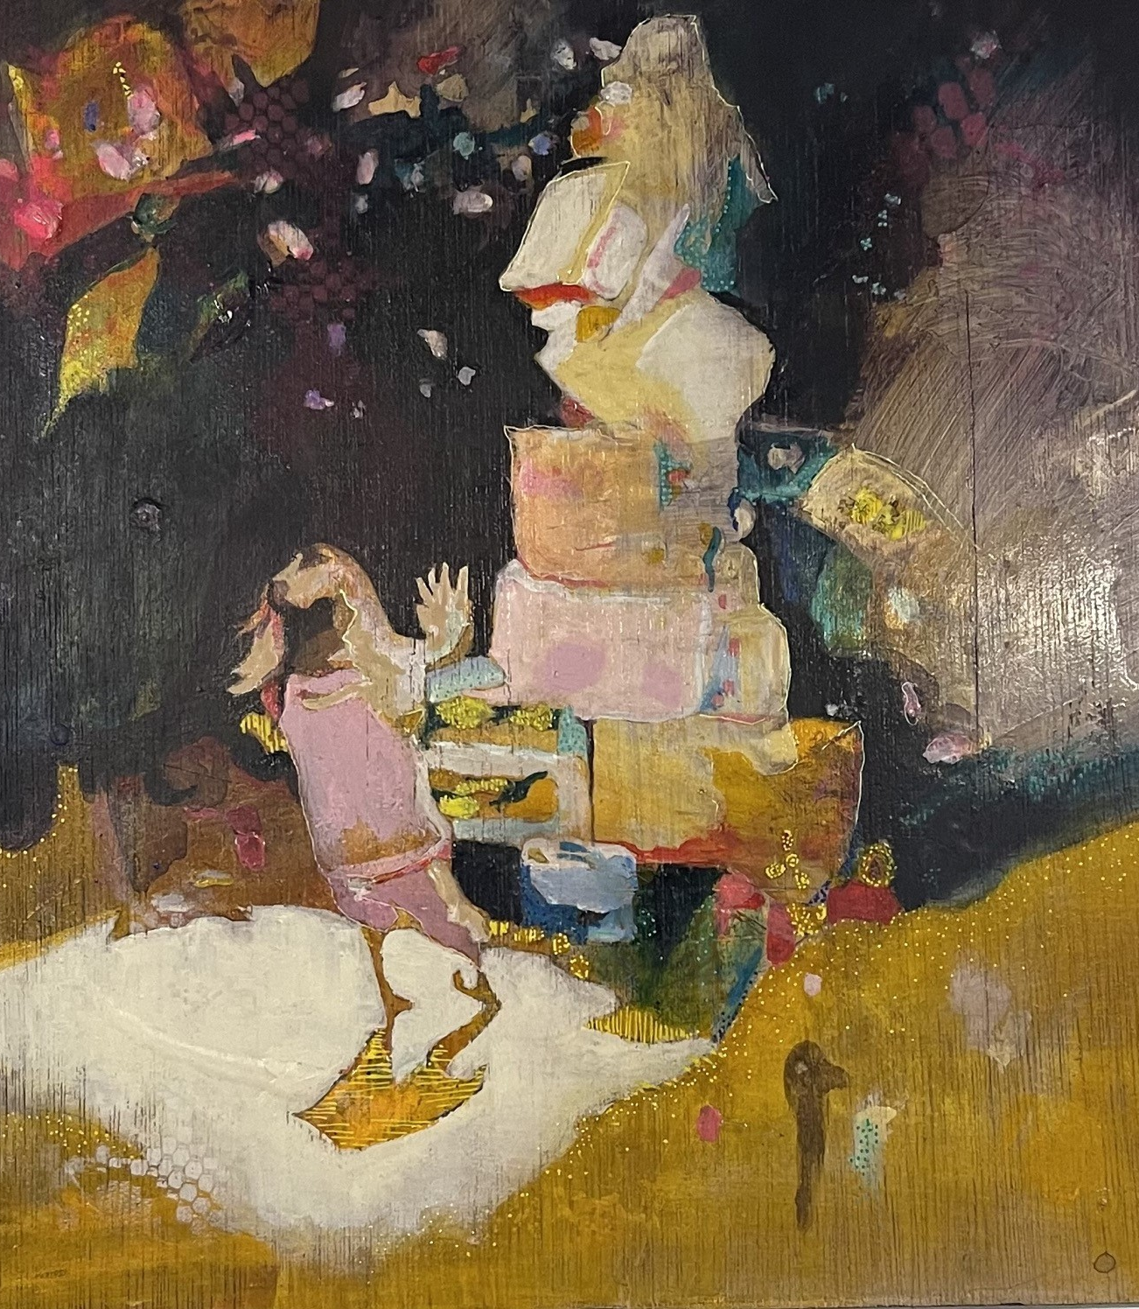
Methods
Proposed Structure
Inquiry 1
Visual Research
Participatory Arts-Based Research leading to exhibition
Narrative Inquiry parallel to visual research
Inquiry 2
Reflexive Autoethnographic inquiry using arts-based methods
Notes:
Arts-based research is apt to my proposed project firstly because of my background in visual arts. Secondly because, as Barone and Eisner describe it is an aesthetic practice and as such extends from and is suited to my existing way of thinking and interpreting and re-presenting the world as an artist.
I am motivated in this project by personal experience and, extending from this, a care for other artist-mother-academics. As such the proposed is emic research, situated in a critical feminist paradigm and bringing to bear a matricentric feminist lens.
This study will utilize a qualitative approach grounded in critical feminist theory, intersectionality, and an ethic of care to explore the lived experiences of mothers who are academics in higher education who also maintain a career in creative practices. This design is chosen to highlight the complexities and explore the strengths and learning deriving from balancing motherhood with professional and artistic identities.
This project is situated within the area of arts-based research (ABR) and will involve production of non-traditional outputs including visual art, narrative, performance and curated exhibitions. These outputs will serve as both research data and dissemination tools, offering a rich and fulsome understanding of the topic. My understanding of ABSR is informed by Tom Barrone and Elliot Eisner’s seminal work from 2012 and Chilton and Levy’s seminal text, the Handbook of Arts Based Research (2014). This area of research is developing and innovative and provides a space in which to engage in shaping understanding of what ABSR offers for engagement and understanding of complex personal and social phenomena

Slide 16
Data Collection
Participants
20-30 Mother-artist-academics
Having been in an academic role whilst being primary carer for at least one child and having a professional creative practice in the visual arts
Recruitment
Professional networks with Curtin and other WA Universities
Artsource (Professional body for artists in WA)
Interviews
Initial demographic survey
Semi-structured interviews (recorded and transcribed)
Western Australian context
Co-construction of project leading to exhibition and catalogue
Coding of interview data to inform artwork created in response
Notes:
The matricentric feminist lens (O’Reilly, 2019) will inform the data collection by prioritizing the lived experiences of mothers, recognizing the complexities of their roles and the societal structures that shape their realities. This approach will guide the selection of participants, ensuring a diverse representation of voices that reflect various backgrounds and experiences within the academic and creative fields.
Incorporating creative methods of analysis, including visual mapping and narrative vignettes, will further enrich the interpretation of the data, aligned with the principles of arts-based research, allowing for a subtle understanding of participants’ experiences and the emotional nuances that accompany them. Imagery and performance are uniquely equipped to provoke and suggest these nuances and the collection of data will be enriched by having these forms of data in addition to that which is collected through interviews.

Slide 17
Significance
This research has the potential to contribute to the fields of arts-based research, and educational leadership. By examining the confluence of parenting, academic and creative identities, the study aims to highlight the challenges and opportunities inherent in the intersection of these roles. It seeks to offer an understanding of how these identities can be successfully integrated in a higher education context, to the benefit of staff, students and institutions, by providing a framework for tertiary institutions that can support others in similar positions of negotiating the intersection of competing commitments and challenges.
The production of non-traditional research outputs in ABR further enhances the significance of this project by expanding the ways in which research findings can be shared and understood, contributing to discourse around ABR in an Australian context, engaging new audiences and enhancing the reliability of findings through adhering to the quality criteria for Arts-Based Research that has been established by Chilton and Levy (2014).

Slide 18
Ethics
Ethical considerations
- Informed Consent
- de-identification of participants in writing
- securing permission to use images of artworks for research purposes. Copyright retained by artists.
Guided by International Charter for Ethical Research Involving Children, available through the Australian Institute of Family Studies
Notes:
I acknowledge that the territory of my proposed project is personal and potentially sensitive, as I seek to hear, share and respond to stories of experience of caring for/with children and the effects on identity and creative and academic practice of women who have navigated challenges. In light of this, part of my consideration of ethics lies in establishing best practice for a caring dynamic for participants. In this I will be guided by my supervisors who have expertise around trauma informed practice. I will seek guidance around directing participants to resources and supports both during and subsequent to participation in the research project.
Ethical considerations will include obtaining informed consent from participants and providing the opportunity for anonymity. Working with creative practitioners and in light of my alignment with matricentric feminist thinking, the matters of voice and identity are acknowledged as important and as something to protect. As Virginia Wolf (1929) is credited as saying, “Anonymous was a woman”. I do not wish to further disempower and limit the expression of participants who are likely to have already encountered marginalisation and silencing.
The questions that I will use to guide the semi-structured interviews have not been developed will be developed in consultation with my supervisors in advance of applying for Curtin Research Ethics, with a focus on best-practice in ethical, caring engagement with participants on achieving candidacy.

Slide 19
Data Management
Data will be managed in line with Curtin Research Management Guidelines.
Physical data will be stored in a locked studio space
Digital data will be stored on password protected files and device.

Slide 20
Data Collection and Analysis
Data will be collected through three sets of interviews. These will be recorded using Webex for transcription and analysis. The initial interview will lead to the production of artworks by participants and myself as participant observer, with a second interview at a mid-point through preparing artwork for exhibition and the final interview taking place after the exhibition.
The group exhibition will not be the culmination of the study but a provocation to the third round of interviews, which will provide refection on the experience and help to construct recommendations for future initiatives to support their practice and to provide a supportive and nurturing community.
Parallel Narrative inquiry will provide data in the form of collected stories which will be analysed to identify common narratives and to inform suggestions for changes to practice to better support creative mothers in higher educational contexts.

Slide 21
Timeline
2025
M1 – Candidacy Due 27.07.25
Refine Proposal
Apply for Ethics
Develop Literature Review Chapter
Recruit Participants
Develop Autoethnographic Vignettes
Attend AARE
2026
Stage 1 Data collection
Semi Structured interviews pre-exhibition
Apply for exhibition venue
2027
Exhibition with participants
Stage 2 Data Collection
Writing Exegesis
Develop Artworks in response to Data Collection
2028
Refining artworks
MS3- Exhibition
Notes:
Full, detailed timeline in appendices

Slide 22
Budget
Funding will be sought through the RSF grants of $2500 each, to cover the costs detailed below, including production of a catalogue to document the exhibition and to give back to the artists who participate in the project.
Cost | Item
Art Materials | $1000
Camera for documentation (inc SD card) | $900
Transcription software | $50
Exhibition venue hire | $1700
Conference Attendance | $500
Catalogue Production and Printing Total | $850 $5000

Slide 23
Thank you
Special thanks to my three wonderful supervisors for their encouragement and brilliance and calm direction.
Thanks also to my friend and colleague, Siobhan Unwin, for being a supportive fellow traveller on this PhD journey and to my kids who are my raison d’etre and my husband for all his staunch support.

Slide 24
References
Barronne, T., Eisner, Elliot W (2012). Arts Based Research, Sage Publications.
Barton, D.K (2008). You are what is most beautiful about me, a self portrait with Kell and Arella [Painting] The Art Gallery of New South Wales, Sydney, Australia.
Black, A., Grimmett, Helen., Walker Amelia (2024). Ludic Enquiries into Higher Education. London, Routeledge.
Boehnke, J., & Gay, V. (2022). The Missing Men: World War I and Female Labor Force Participation. Journal of Human Resources 57(4), 1209-1241. https://muse.jhu.edu/article/857672.
Borzello, F. (2018). Seeing Ourselves: Women's Self-Portraits. London, Thames & Hudson.
Bourgeois, L. (1999). Maman [Sculpture]. The Guggenheim, Bilbao, Spain.
Buliung, R., et al. (2022). "Behind the Paintbrush: Understanding the Impact of Visual Arts-Based Research (ABR) in the Lives of Disabled Children and Youth as well as Methodological Insights in ABR Application." Canadian Journal of Disability Studies 11: 119-160.
Castañeda, M., Isgro, Kirsten Ed. (2013). Mothers in Academia. New York, Columbia University Press.
Chilton, G., and P. Leavy. 2014. “Arts-based Research Practice: Merging Social Research and the Creative Arts.” In Oxford Handbook of Qualitative Research, edited by P. Leavy, 403–422. New York, NY: Oxford University Press.
Dalla-Camina, M. (2024, September 11). The Motherhood Paradox. Women Rising. https://www.facebook.com/womenrisingco/videos/for-many-working-mothers-the-challenge-of-balancing-career-aspirations-with-the-/529722836252792/
de Beauvoir, S. (2015). The Second Sex. London, Penguin.
Dwyer, R., Trocchio, Sarah,. Jorgenson Borchert, Jessica ,.Hanasono, Lisa K., Yih Harvie, Jeanette Ed. (2023). It Takes a Village: Academic Mothers Building Online Communities, Springer.
Francis, L., & Stulz, V.(2020). "Barriers and facilitators for women academics seeking promotion " Australian Universities' Review 62(2): 47-50.
Fulweiler RW, Davies SW, Biddle JF, Burgin AJ, Cooperdock EHG, Hanley TC, et al. (2021) Rebuild the Academy: Supporting academic mothers during COVID-19 and beyond. PLoS Biol 19(3): e3001100. https://doi.org/10.1371/journal.pbio.3001100
Gallagher, C., & Judah, H. (2022). Artist Mothers & Other Parents: Love, Celebration and the Road Ahead: The Second Shift. Exhibition, TJ Boulting Gallery. https://www.tjboulting.com/hettie-judah-artist-mothers-other-parents-love-celebration-and-the-road-ahead
Greer, G. (1979). The Obstacle Race. London, Book Club Associates.
Krznaric, R. (2015). Empathy: Why it matters and how to get it. New York, Tarcherperigee.
Laderman-Ukeles, M. (1969). Manifesto for Maintenance Art. Philadelphia.
Lee, Theresa Man Ling. (2007). "Rethinking the Personal and the Political: Feminist Activism and Civic Engagement." Hypatia 22(4): 163-179.
Linder, E. (2024, September 17). With Amazon ordering all staff back into the office, what can you expect from your workplace? ABC News.
Lykke, N. (2010). Feminist Studies: A Guide to Intersectional Theory, Methodology and Writing Routeledge.

Slide 25
Manakil, J., Pickard-Smith, Kelly,. Neumann, Michelle M., Ronksley-Pavia, Michelle Ed. (2023). Academic Women: Voicing Narratives of Gendered Experience, Bloomsbury Publishing.
Mann, S. (1999). Goosebumps [Photograph]. Edwynn Houk Gallery, New York, USA.
Morimura, Y. (2003). Daughter of Art History. Hong Kong, Apperture.
“m/other voices,” Artist Parent Index , accessed October 6, 2024, https://www.artistparentindex.com/items/show/98.
Mula-Falcón, J., et al. (2021). "Being a female academic under neoliberal evaluation: A systematic review." Research Evaluation: 1-11.
Nochlin, L. (1971). "Why Have There Been No Great Women Artists?" ARTnews January.
O'Reilley, A. (2007). Maternal Theory: Essential Readings, Demeter Press.
O’Reilly, A. (2019). Matricentric Feminism: A Feminism for Mothers. Journal of the Motherhood Initiative for Research and Community Involvement, 10(1/2). Retrieved from https://jarm.journals.yorku.ca/index.php/jarm/article/view/40551
Paglia, C. (1990). Sexual Personae. London, Random House.
Palfreyman, K., Carpenter Estrada, Tara ., Wolfley, Hilary Ed. (2024). Give and Take: Motherhood and Creative Practice, Demeter Press.
Parker, R., Pollock, Griselda. (1981). Old Mistresses: Women, Art and Ideology. London, Pandora Press.
Pratchett, T. (2011). Snuff. London, Doubleday.
Rego, P (1987). The Maids [Painting] Saatchi Gallery, London, UK.
Rich, A. (1976). Of Woman Born. New York, Virago.
Rose, J. (2005). Sexuality in the Field of Vision, Verso.
Saville, J. (2009-10). Reproduction drawing I (after the Leonardo cartoon) [Drawing]. The Gagosian, London, UK.
Scarry, E. (1999). On Beauty and Being Just. Princeton, NJ., Princeton University Press.
Sherman, C. (1978). Untitled Film Still [Silver Gelatin Print]. MoMA, New York, USA.
University of Phoenix. (2023). Mothers Overcome More (M.O.M) report https://www.phoenix.edu/career-institute/mothers-overcome-more.html
Ward, F., Haug, Kate., Mertes, Cara. (1992). Dirt and Domesticity: Constructions of the Feminine. New York, Whitney Museum of American Art.
Warner, M. (1994). Managing Monsters: Six Myths of our Time. London, Vintage.
Whitehouse, A., Farquson, Matt (2017). Parenting the Sh*t Out of Life. London, Hodder and Stoughton.
Williams, J. (2015). The Glass Ceiling and the Maternal Wall in Academia.
Woolf, V. (1929). A Room of One's own. London, Hogarth Press.
Wollstonecraft, M. (2004). A Vindication of the Rights of Women. London, Penguin Books.
Yngvesson, T., et al. (2020). Mentoring in the Academy Between Academic Mothers. (Re)birthing the Feminine in Academe: Creating Spaces of Motherhood in Patriarchal Contexts. L. Henderson, A. L. Black and S. Garvis. Cham, Springer International Publishing: 165-184.

Slide 26
Appendices
Data Collection and Analysis
Full Timeline
Why ABR
Recent Professional Arts Practice Acknowledgment
From the Literature

Slide 27
Full Timeline
 | Jan | Feb | Mar | Apr | May | Jun | Jul | Aug | Sept | Oct | Nov | Dec
2025
Milestone 1 – Candidacy Due 22.07.25
Refining Proposal
Application for ethics approval
Development of Literature Review chapter
Recruitment of Participants
Development of Autoethnographic Narrative Vignettes
Australian Association of Research in Education Conference (attend)
2026
Development of Methodologies chapter
Refinement of Literature Review chapter
Refine interview questions
Semi-structured interviews
Coding of data from interviews
Apply for Exhibition Venue
Transcription of observation and interview recordings
Analysis of observation and interview data
2027
Milestone 2 –22.07.2027
Development of narrative vignettes
Refinement of Methodologies chapter
Conference
Second round of interviews (during production of artwork)
Transcribing, coding and analysis of interviews
Artworks - responding to interviews
2028
Exhibition
Conference
2029
Third round of interviews – post exhibition
Coding and responding to interview data
Conference
2030
Develop Thesis
Conference
2031
Exhibition (date tbc)
Conference
Refining thesis (including professional editing.)
2032
Exhibition
Conference presentation AARE
Milestone 3 – Pre-submission due 22.01.32
FEC date 22.07.32

Slide 28
Why ABR?
Eliot Eisner and Thomas Barone describe Arts-Based Research as relying on aesthetic judgement, implying a sort of visual literacy (2012) :
“[A]rts based research is the utilisation of aesthetic judgment and the application of aesthetic criteria in making judgements about what the character of the intended outcome is to be. In arts based research, the aim is to create an expressive form that will enable an individual to secure an empathic participant in the lives of others and in the situations studied. ”
As a visual artist with a professional arts practice, I have an established aesthetic language and corresponding visual language, an expertise that my participants will share.

Slide 29
Recent acknowledgment of Professional Arts Practice

Slide 30
From the Literature…
Artist Mother
In 2023 only 32% of artists represented in London galleries were women.
Mother and Domestic Labour
In 2020, 86% of women juggling domestic and work responsibilities reported mental health issues (Marsh 2020)
Academic Parent
Gendered challenges for “ParentScholars” in American Universities(Finley and Rudnick, 2022)
Challenges of balancing parenting and academia (Kamasak and Alkan 2025)

